Slide 1
Artificial Intelligence in Video Games
Kaleb, David, Rodney, Trevor

Slide 2
Presentation Overview
General Overview of AI
What’s AI?
Why use AI for Games?
Chess - Decision Tree Navigation
FEAR - Finite State Machines
Deterministic Search Algorithms
What is a deterministic search?
What are they used for?
Uninformed vs Informed
Examples
Search Algorithm
Graph Theory
Search Algorithms
CSP
Adversarial Search Algorithms
Machine Learning
What is machine learning?
Deep Learning
Machine Learning to Play Games
AlphaStar and DeepMindAI

Slide 3
AI - Overview and Examples
Kaleb Johnson

Slide 4
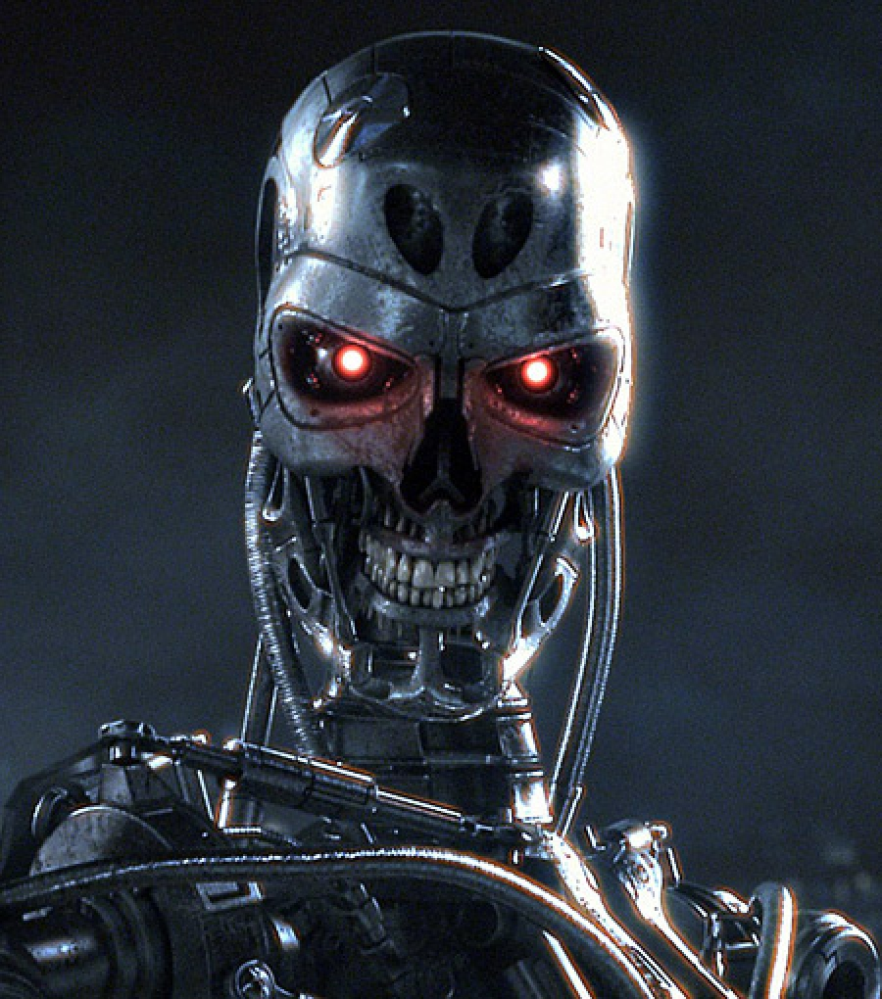
Artificial Intelligence
Pop culture icons
Bogeymen: Terminator, 2001
Examination of ourselves: Ex Machina, Asimov, Frankenstein
Notes:
Visuals - Terminator for Bogeyman, Social media for modern world, something old timey for video games - (Civ?). Add transitions to make things come in line by line, accompanied by visuals, then visuals fade out as next line comes in.

Slide 5

Artificial Intelligence
Ubiquitous part of the modern world.
Content delivery algorithms
Data analysis - Makes free services profitable
So many other tools
Notes:
Visuals - Terminator for Bogeyman, Social media for modern world, something old timey for video games - (Civ?). Add transitions to make things come in line by line, accompanied by visuals, then visuals fade out as next line comes in.

Slide 6

Artificial Intelligence
Central to Most Video Games
Core to single-player interactions
Provides tools for multi-player experiences
Notes:
Visuals - Terminator for Bogeyman, Social media for modern world, something old timey for video games - (Civ?). Add transitions to make things come in line by line, accompanied by visuals, then visuals fade out as next line comes in.

Slide 7
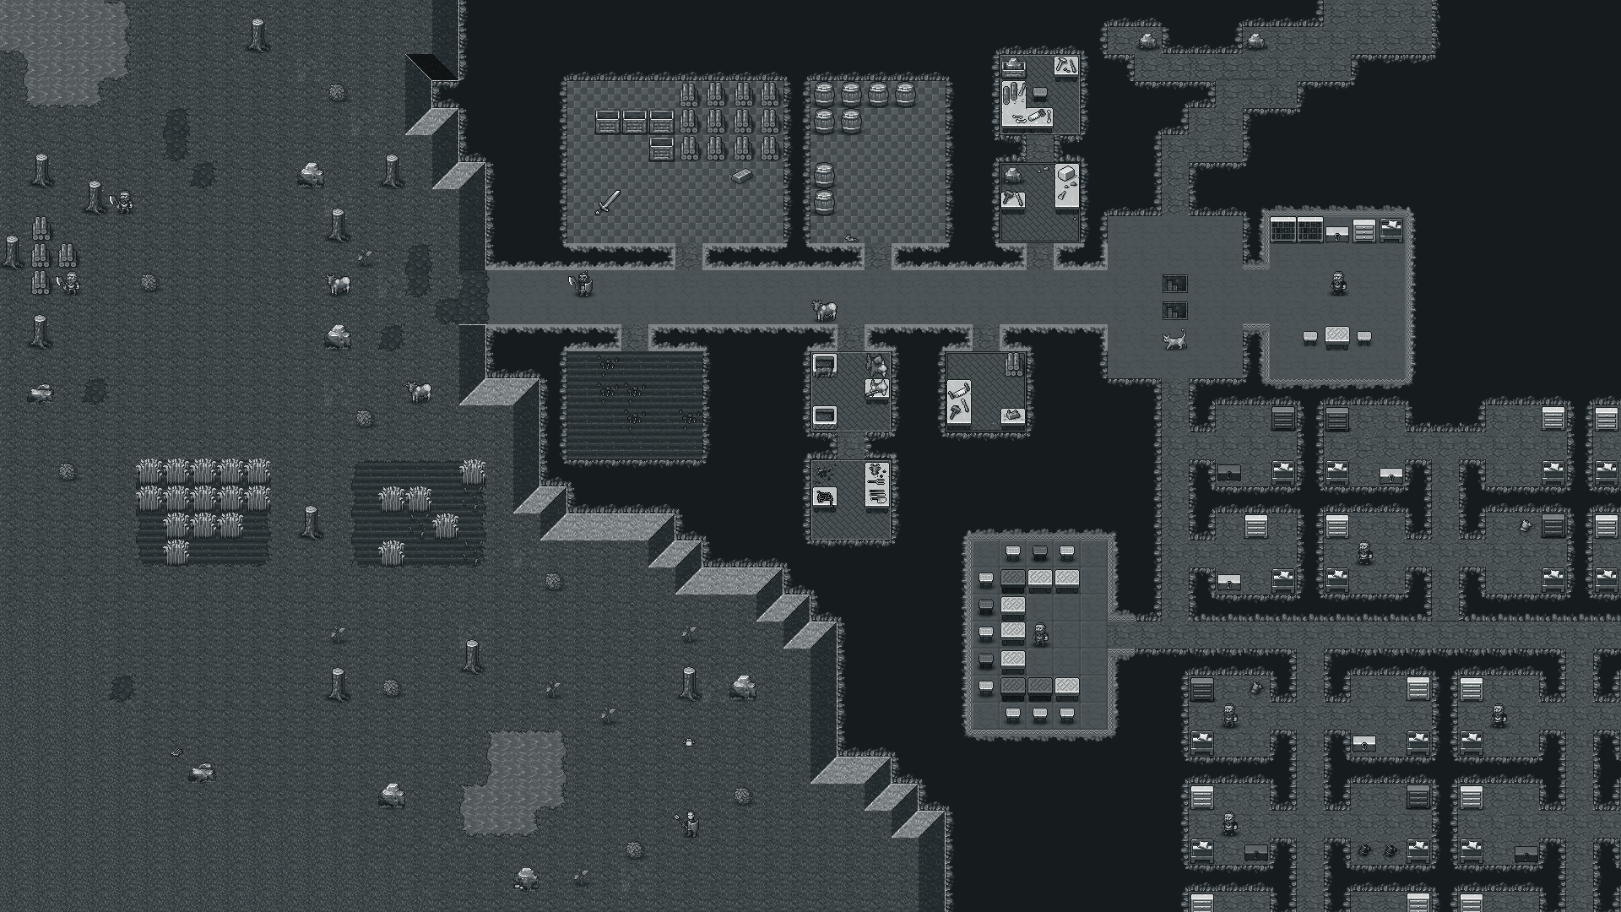
AI in Games
Simulate the world
Challenge players as enemies
Interface with all of your systems to create interesting behavior

Slide 8
Two Examples
Chess
Classical Board Game
Most well-documented game AI
F.E.A.R.
2005 First Person Shooter
Legendary for enemy AI

Slide 9
Chess AI
Easily mathematically represented
Perfect Information
Evaluations are easy to implement
Long history and multitude of approaches

Slide 10
Chess - Decision Trees
Evaluate a board
Checkmate
Piece Point Evaluation
Further Methods
Pawn Structure, Trapped Pieces, King Weakness, Center Control, etc.
Notes:
Maybe pull up chess.com to show off chess

Slide 11
Chess - Decision Trees (2)
Analyze possible moves
Evaluate the board at the new positions
Evaluate the board after the opponent’s move
Notes:
Maybe pull up chess.com to show off chess

Slide 12
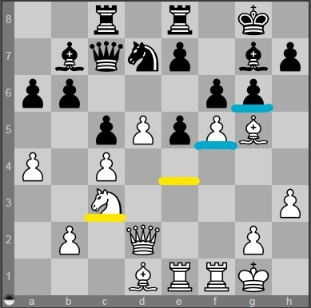
Chess - Decision Tree Example (1)
Notes:
Maybe pull up chess.com to show off chess

Slide 13
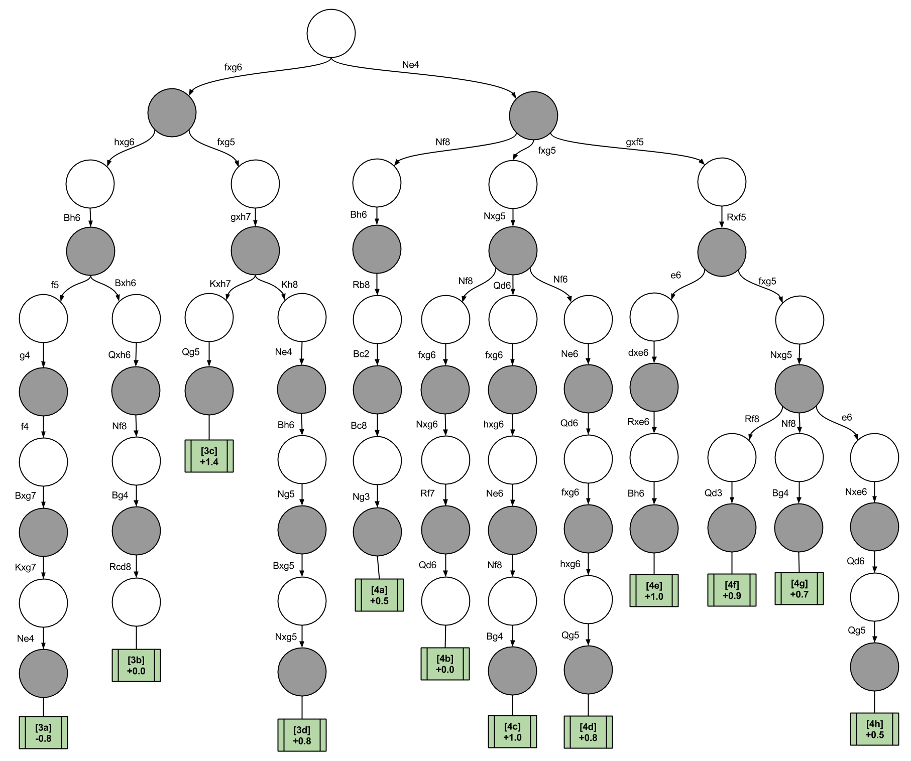
Chess - Decision Tree Example(2)

Slide 14
Chess - Exceptions
Opening Books
DeepMind and AlphaGo

Slide 15

F.E.A.R.
2005 First Person Shooter
Legendary AI
Simple techniques
FSM
A*
GOAP

Slide 16
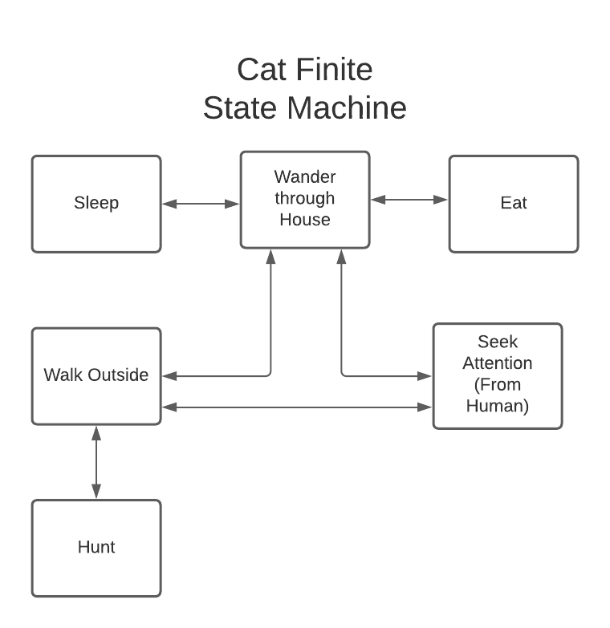
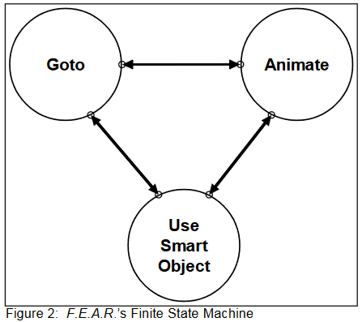
F.E.A.R. - Finite State Machines

Slide 17
F.E.A.R. - Planning System
STRIPS/GOAP are Planning Systems
Stanford Research Institute Problem Solver
Goal Oriented Action Planning
Entities have goals and actions

Slide 18
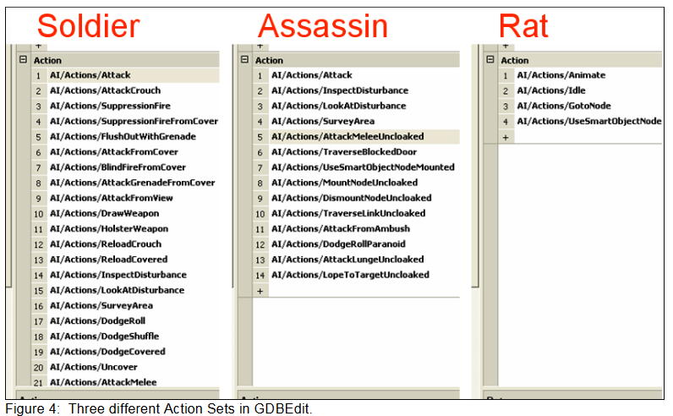
F.E.A.R. - GOAP Example Actions
2

Slide 19
F.E.A.R. - Planning Hierarchies
Goals are Ranked
Actions have Costs
A* is used to search the Decision Space

Slide 20
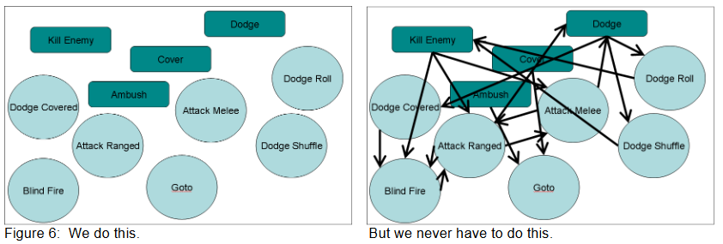
F.E.A.R. - Results of GOAP

Slide 21
F.E.A.R. - Simple but Effective Design
Not managing every interaction
Fitting your AI to your game
Tailoring information to players

Slide 22
Deterministic Search Algorithms
David Bush

Slide 23
Deterministic vs Non-deterministic
A deterministic algorithm can determine what the next step will be and will always have the same output even if the input remains the same.
A non-deterministic algorithm can’t determine the next step because there are more than one path it could take. It will also give different outputs with different executions for the same input.

Slide 24
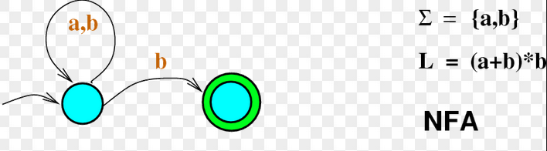
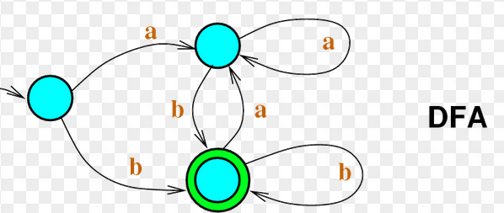
NFA vs DFA

Slide 25
What is a Deterministic Search?
A search that’s output won’t change given the same input.
It also will find a solution if one exists. If there is no solution then it will have checked every possible one. Can be limited by the amount of time it has to search. (Complete search)
Can determine what the next step in the search will be. (Not random)

Slide 26
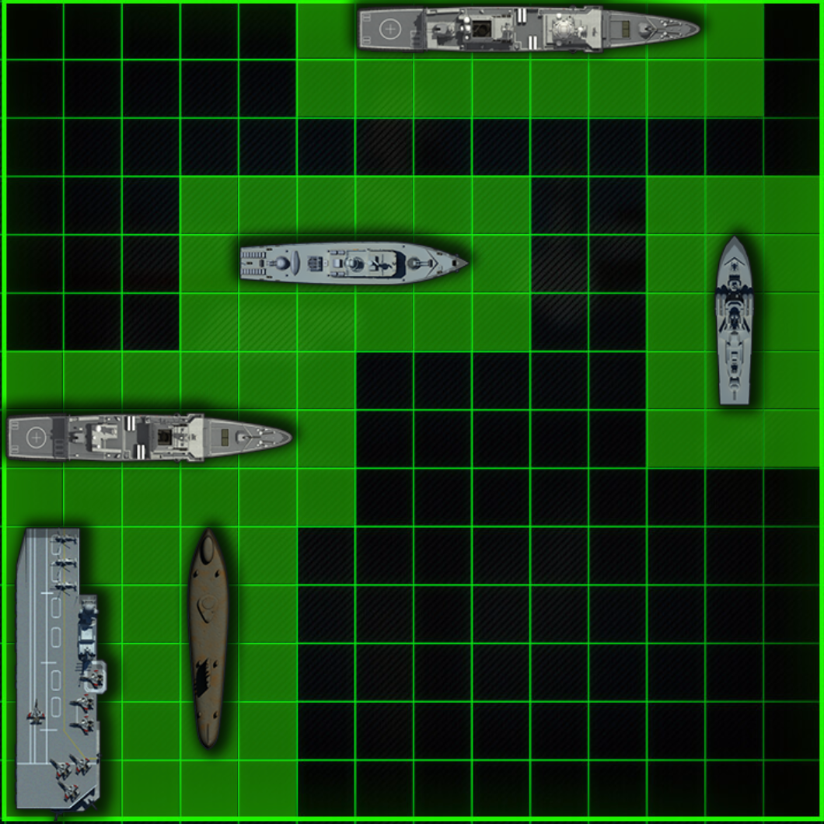
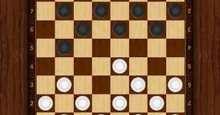
What games are deterministic?
Imperfect information
Battleships, minesweeper
Perfect information
Chess, checkers, connect4, Nim, tic-tac-toe

Slide 27
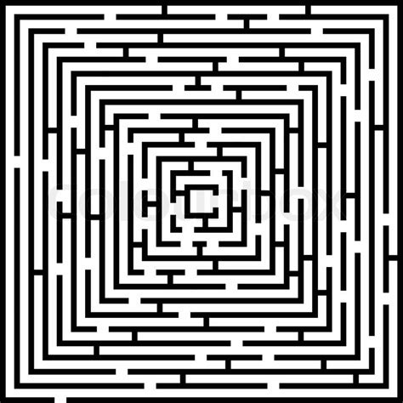
Deterministic Searches
Uninformed
Doesn’t have additional information, such as how far away the goal is.
Informed
Has additional information like knowing how far away the goal currently is. (Heuristic)

Slide 28
Uninformed Searches
Depth-first Search
Starts at the root and explores each branch as far as it can go before backtracking or a solution is found.
Not optimal
Breadth-first Search
Starts at the tree root and explores all the nodes at a given level of the tree before moving to the next level.
Finds the optimal solution in the shortest number of actions/moves

Slide 29
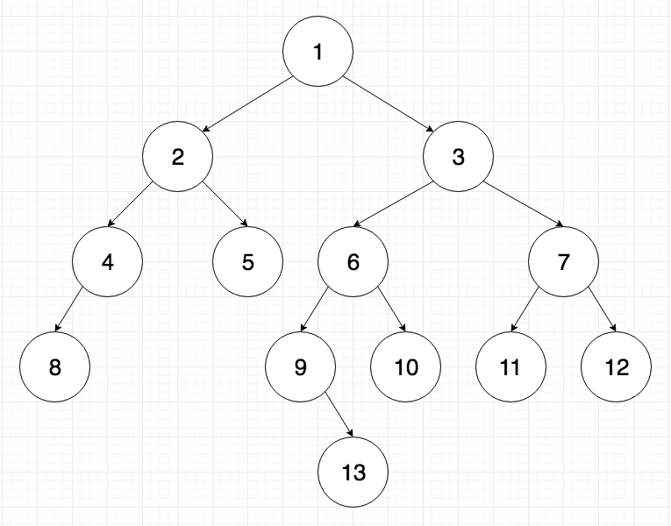
Depth-first vs Breadth-first
DFS
BFS

Slide 30
Informed Searches
Greedy Best-first Search
Similar to Breadth-first
Uses a heuristic h to estimate the distance from the goal
Sorts the queue/open list by the h value
Not optimal
A* Search
Similar to the Greedy
Uses the total cost to reach the state as c
Sorts the queue/open list by the c+h value
Finds path with least cost

Slide 31
What is a Heuristic?
Some form of ‘knowledge’ that can lead to a solution faster. Such as estimating how far away the goal is.
It only finds an optimal solution if the heuristic is admissible (never overestimates).
The different types of heuristics each have different ways of calculating their values.

Slide 32
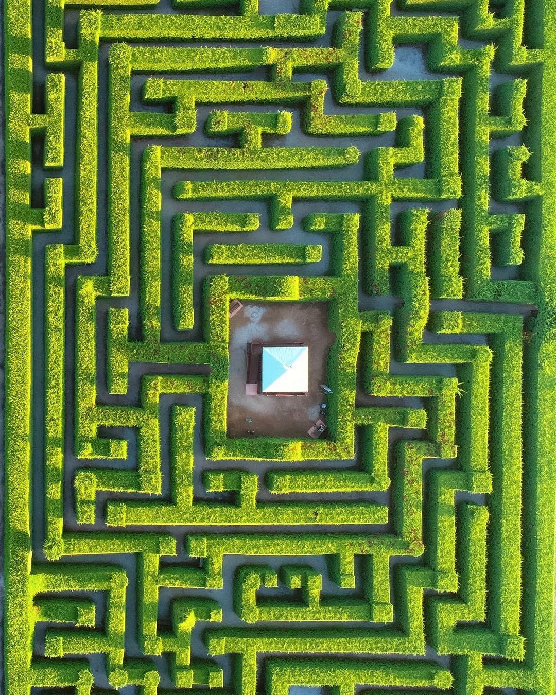
Visual Example
https://qiao.github.io/PathFinding.js/visual/

Slide 33
Search Algorithms
Rodney McCoy

Slide 34
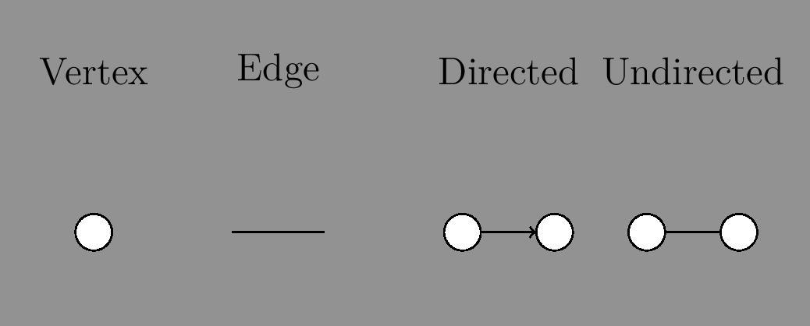
Graph Theory - Review

Slide 35
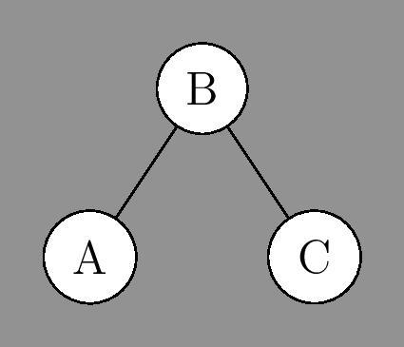
Graph Theory - Review
Two vertices are adjacent if
Their is a single edge separating them
The open neighborhood of a vertex v is
Every vertex that is adjacent to v

Slide 36
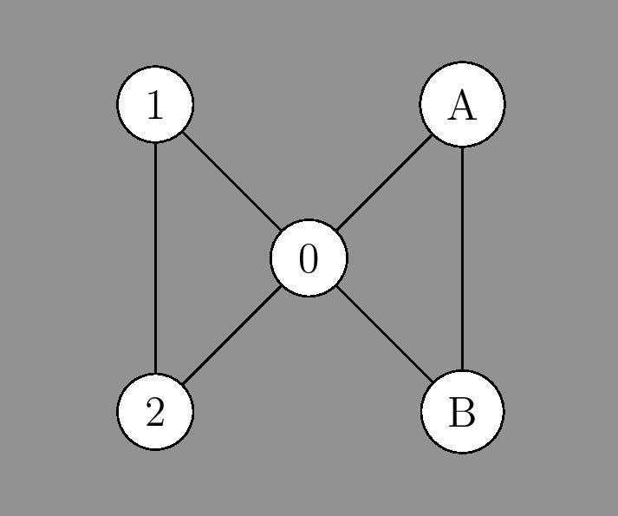
Graph Theory - Walk
A walk is
A sequence of vertices such that the edges between each vertex is in the graph
A path is
A walk with distinct vertices (i.e. no repeated vertices)

Slide 37
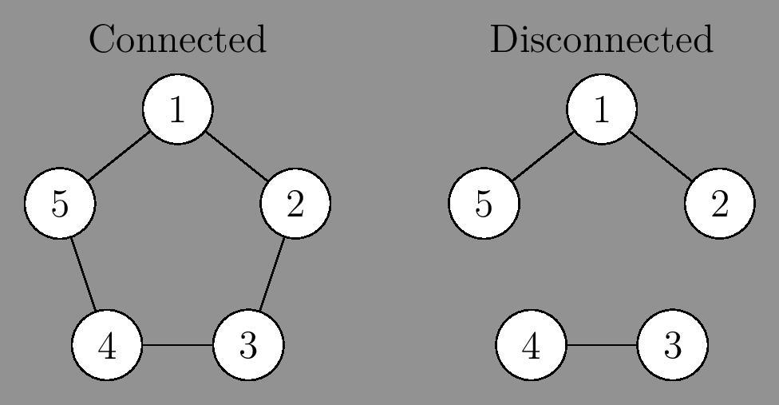
Graph Theory - Connected
A graph is connected if
Every pair of vertices can be joined by a path

Slide 38
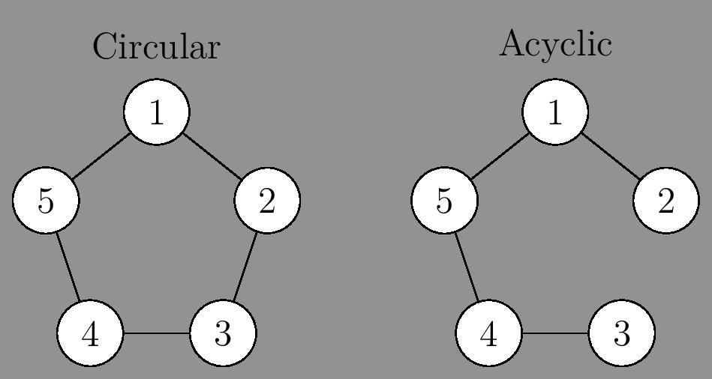
Graph Theory - Cycles
A cycle is
a path of length ≥ 3 with the first and last vertex being repeated
Ex: The 1-5 walk and (1, 5) edge represents the cycle of the vertices (1, 2, 3, 4, 5, 1)

Slide 39
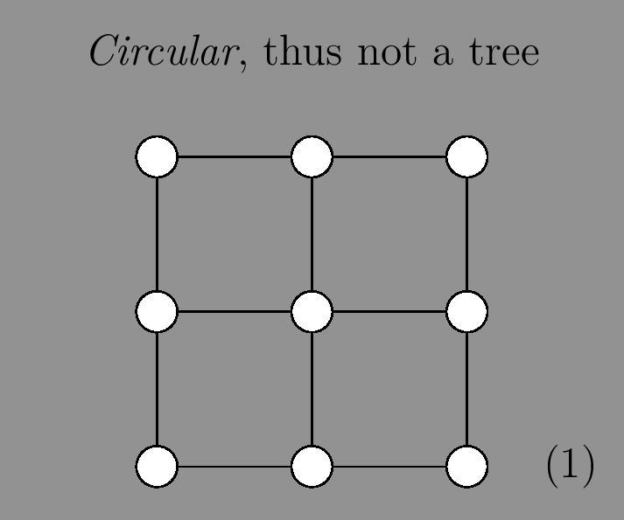
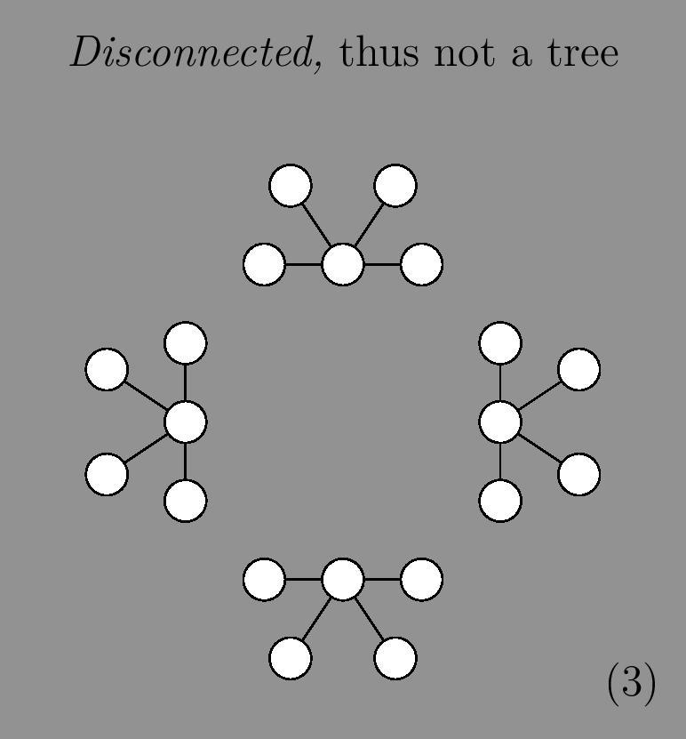
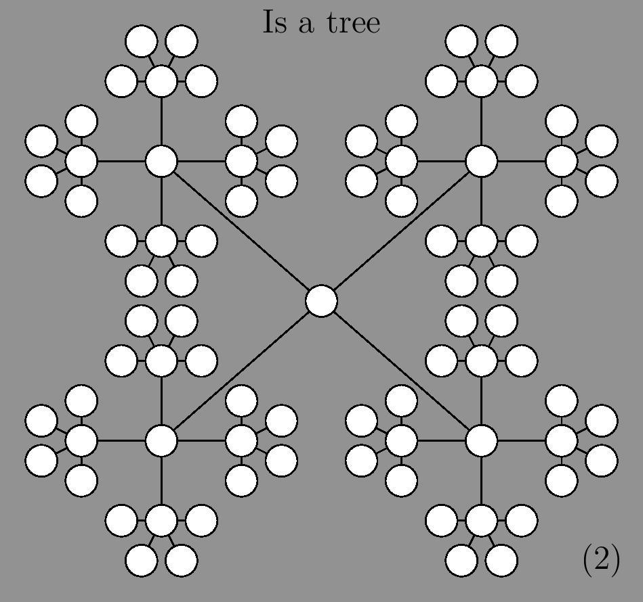
Graph Theory - Trees
A Tree is a Graph that is
Connected
Acyclic
*and undirected
I will use “Tree” and “Search Tree” interchangeably
This is called a forest

Slide 40
Graph Theory - Are Trees Directed or Undirected
In Mathematics
A Tree is undirected
In Computer Science
A Tree is directed and rooted
A Rooted Graph is
A graph where one node is labeled in a specific way to differentiate it from the rest

Slide 41
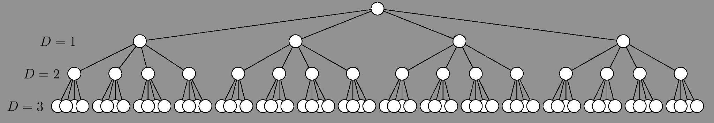
Graph Theory - Trees 2
A Tree is a Graph that is
Connected
Acyclic
Example (2) from the previous slide
Branching Factor: 4
Depth: 3

Slide 42
Search Algorithms
Pathfinding is a subset of the problems search algorithms can solve.
Any problem that can be represented with a search tree, can be solved using search algorithms.

Slide 43
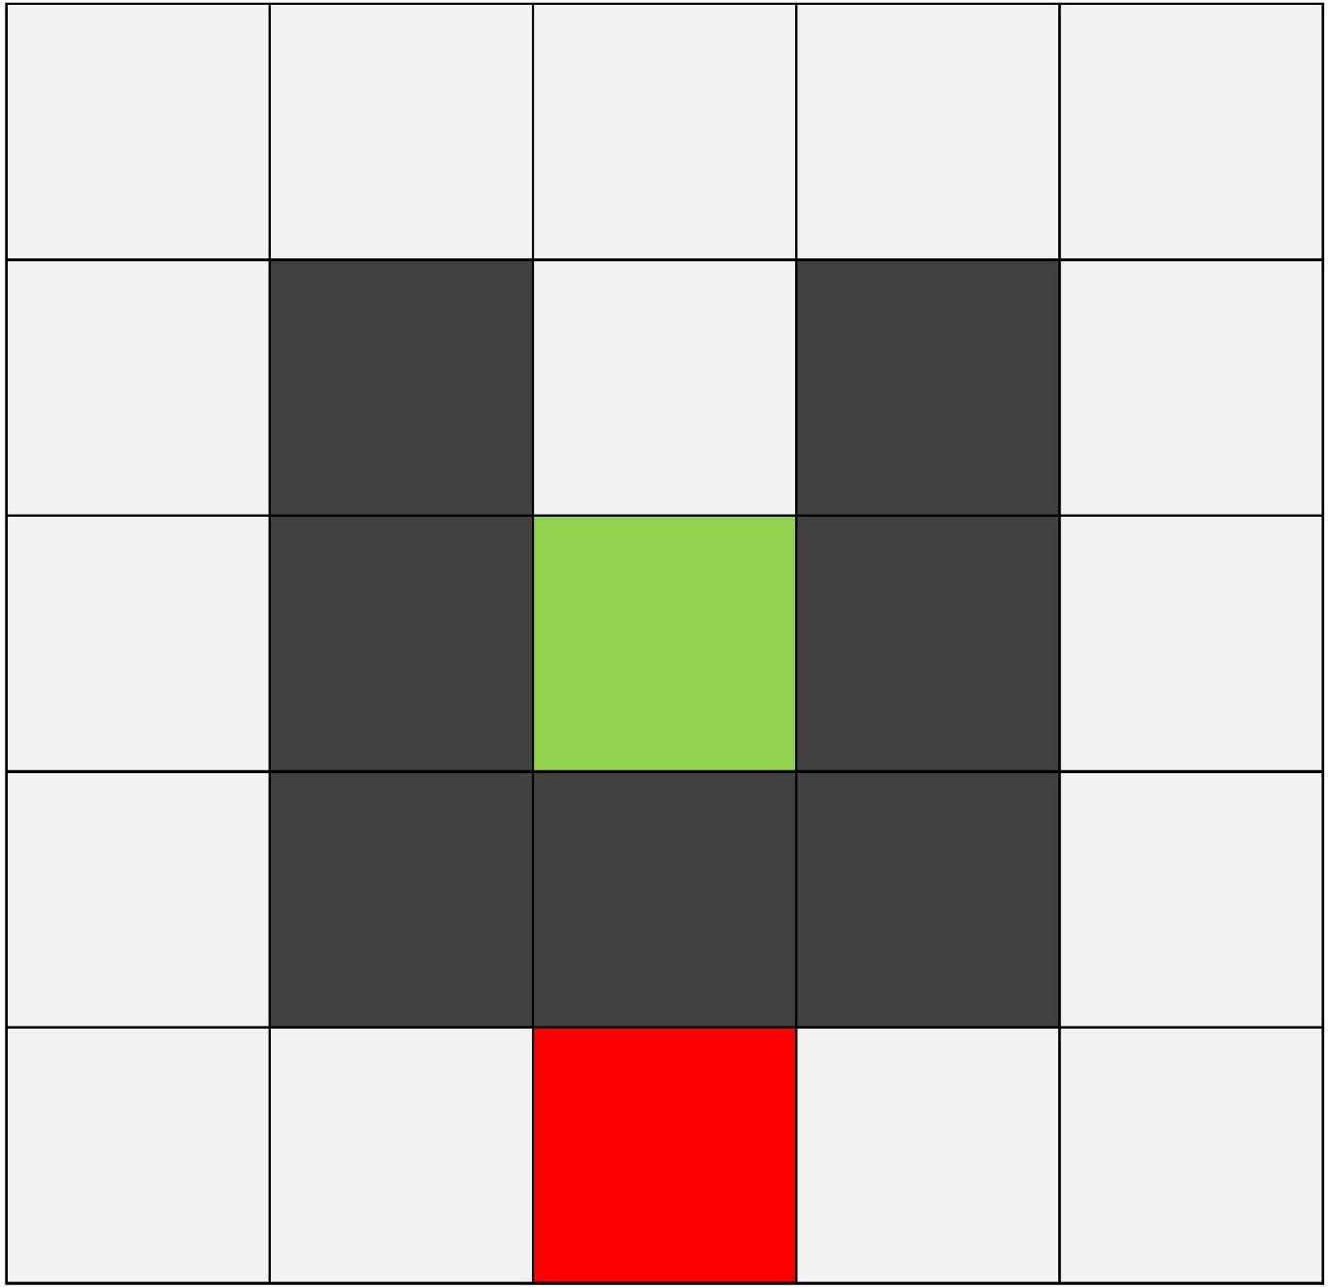
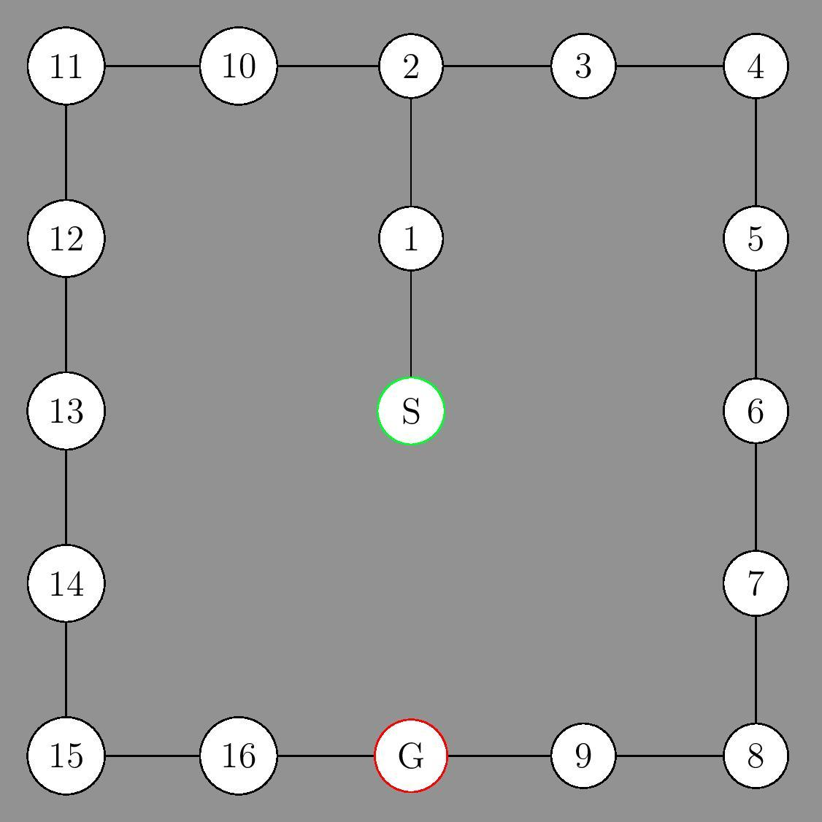
Search Algorithms - Back to Pathfinding
This pathfinding environment on the left can be represented as the graph on the right

Slide 44
Search Algorithms - Issues
Clearly not a tree. Its circular.
What happens when we perform a Greedy Best Search on this graph?

Slide 45
Search Algorithms
If our search ignores vertices that are already discovered, we can ignore any cycles, which dynamically converts any graph into a tree
Therefore, any problem that can be represented with a graph, can be solved using search algorithms

Slide 46
DFS is complete.
So we know there is no solution

Slide 47
Any problem that can be represented with a search tree, or a graph, can be solved using search algorithms
So. What are some of these problems?

Slide 48
CSP
Constraint Satisfaction Problem
Formal Definition
3 Tuple (X, D, C)
X is a set of variables
D is the set of domains, one for each respective variable
C is a set of constraints

Slide 49
CSP
Define the constraints we want to satisfy
Apply a DFS to a search tree where we take each variable and assign it the next applicable value in its domain.
Backtrack if a constraint is violated (Backtracking)
Finish when every variable is assigned a value and no constraint is violated

Slide 50
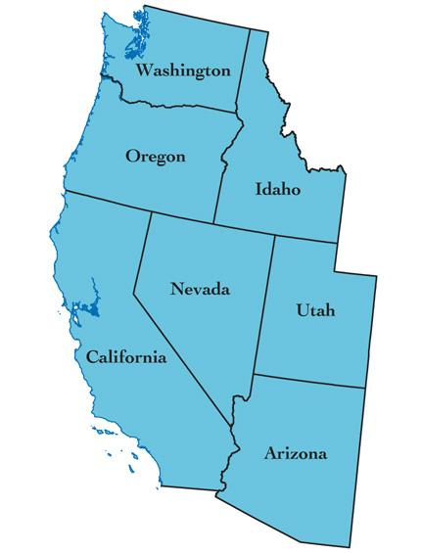
Map Coloring Constraints
Create a graph to define our constraints where:
Each vertex is a region
Each edge is a border between two regions

Slide 51
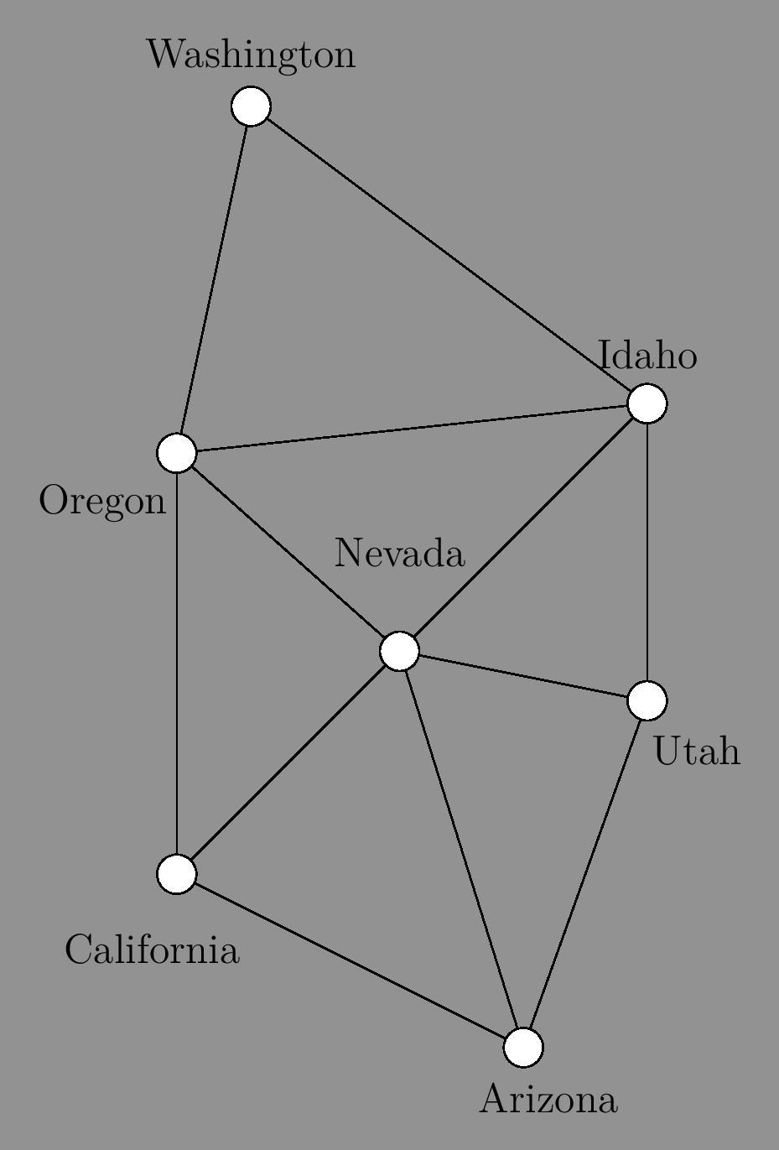
Map Coloring Constraints
NOT THE SEARCH TREE.
Just a representation of our problem as a graph to define the constraints we must satisfy, namely:
For every vertex, no vertex in its open neighborhood can have the same color as itself

Slide 52
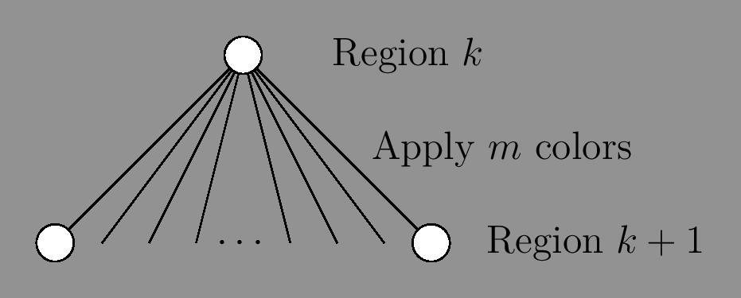
Map Coloring Search Tree
Each vertex is a region (variable)
Each edge is a color applied to that region (value in domain)
Backtrack if a constraint is violated

Slide 53
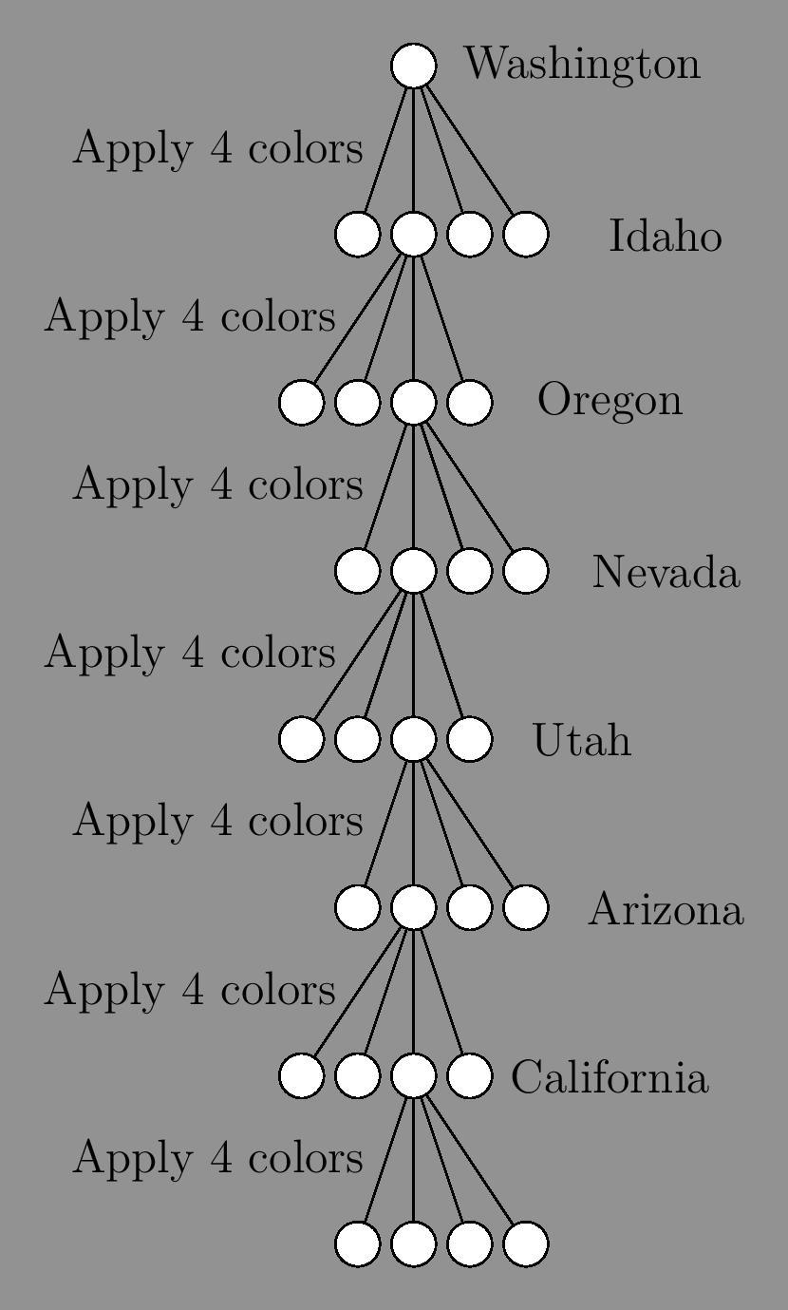
CSP - Map Coloring Search Tree
Our search completes when we reach a leaf vertex without violating any constraints
A leaf is a
Vertex in a tree that is adjacent to only one other vertex

Slide 54
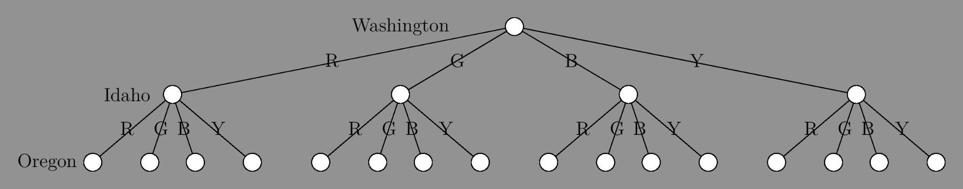
CSP - Map Coloring Problem
Search Tree

Slide 55
CSP - Summary
We defined a graph to easily represent the constraints we had to satisfy
We defined the search tree we wanted to DFS through. We then assigned a value to each variable, backtracked as soon as any constraint was violated, and completed once we reached a leaf vertex.
We don't explicitly store the discovered vertices since we are searching through a tree

Slide 56
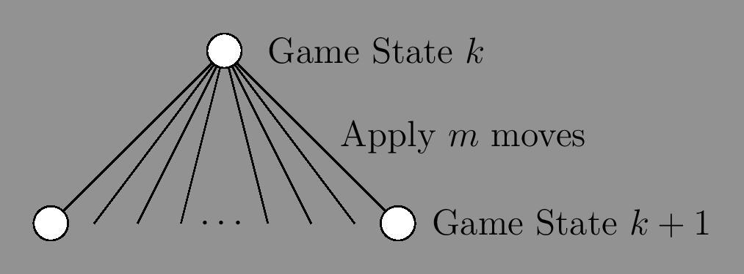
Adversarial Search
We have a search tree.
Let each vertex be a game state.
Let each edge be a game move.

Slide 57
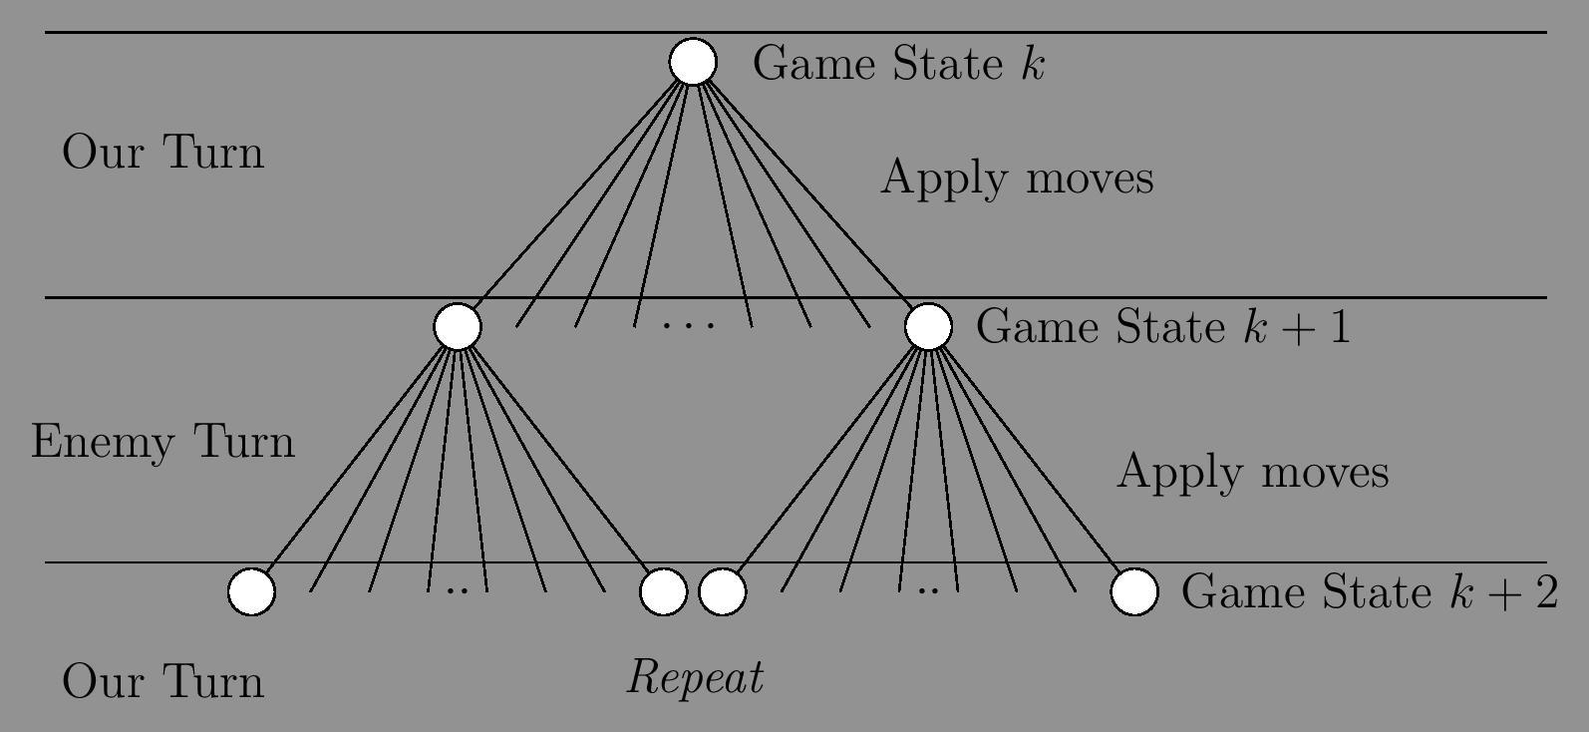
Adversarial Search
We have a search tree.
Let each vertex be a game state.
Let each edge be a game move.

Slide 58
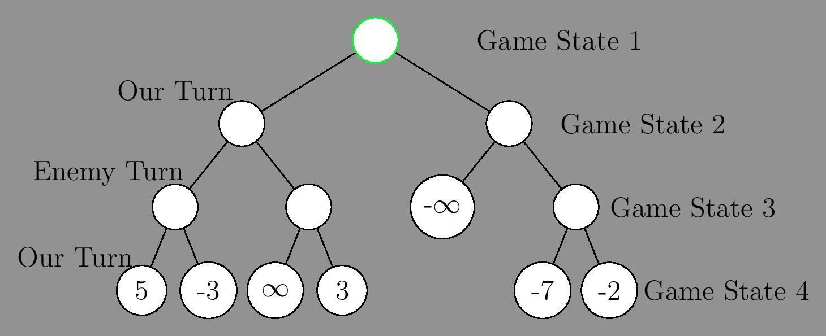
Adversarial Search
5
Leaf vertices assigned utility by utility function
Each non leaf vertex assigned value based off children (min-max)
5
-∞
5
∞
-2

Slide 59
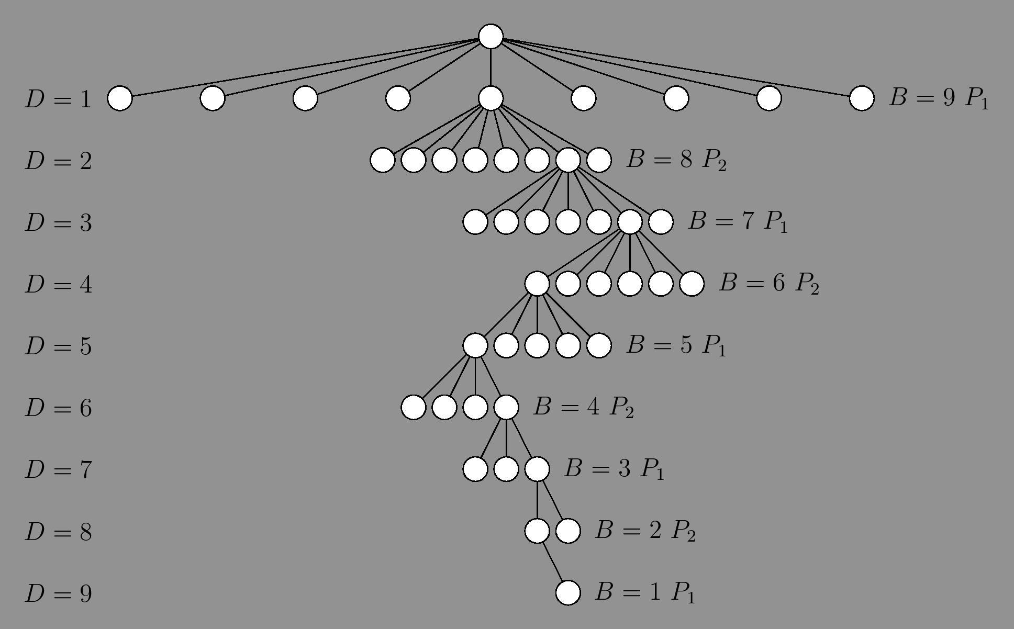
Adversarial Search - Tic Tac Toe
We backtrack when a game ending condition occurs (win / loss / draw).

Slide 60
Adversarial Search - Summary
By performing an exhaustive DFS, we assign each leaf vertex a utility from the utility function, and assign each non-leaf vertex a utility dependent on its children plus which players turn it was.
We don't explicitly store the discovered vertices since we are searching through a tree

Slide 61
Machine Learning/Neural Network
Trevor McGeary

Slide 62
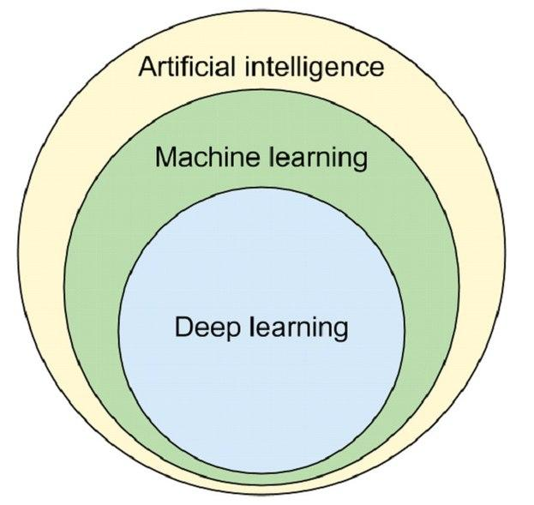
What is Machine Learning?
Using algorithms and statistical models to make machines act without specific programming.
Machine learning is a part of a greater whole in Artificial Intelligence
Machine learning greatly involves the use of Deep Learning

Slide 63
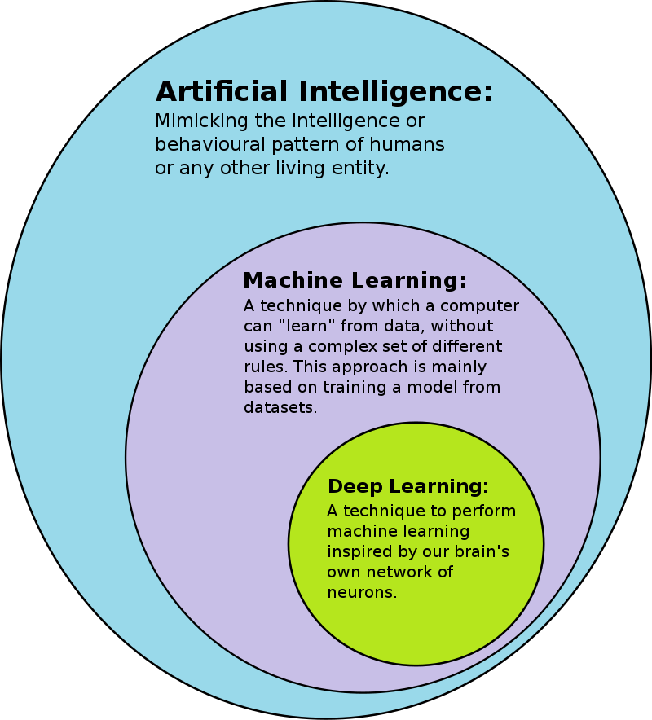
Deep Learning
Based on our brain’s network of neurons
Deep learning uses multiple layers of artificial neural networks to learn and solve tasks.
Some applications of deep learning are image recognition, language processing, and advertising selection

Slide 64
Back to Machine Learning
Machine Learning uses Intelligent Agents to solve problems
Machine Learning is not widely used in video game development, but is used in playing video games.
General Game Playing or Specific Game Playing
Different methods of using machine learning to play video games, such as using deep learning agents or using computer vision.

Slide 65
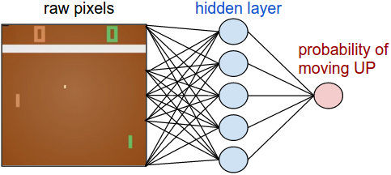
Computer Vision Approach
Utilizing the image recognition of deep learning, but taken to the next level
Take input from screen data, pass through neural network, produce output corresponding to game input
Examples: Pong (Pictured here), Doom (1993)

Slide 66
Intelligent Agent Approach
Use intelligent agents to take the place of human players
Seen in board games like Chess and Go
In video games, seen in strategy games such as DOTA and Starcraft
Agents have shown results to rival or even surpass human players in competition

Slide 67
Machine Learning to Play Games: Starcraft
Starcraft is already a deeply complex game to play for humans
Need to have knowledge of game units, game mechanics, and have knowledge of unit control.
Also need to have a balance between big-picture economy management and low-level control of individual units

Slide 68
AlphaStar
AlphaStar is generated by a deep learning neural network, that receives input from the game, and outputs instructions that constitute an action within the game.
Additionally, AlphaStar’s neural network was trained using replay data from players.
Hundreds of intelligent agents were built that experienced the equivalent of 200 years of StarCraft playtime.
Then, a competitive league was created were different agents played against each other, with strategies growing and evolving as the league went on.

Slide 69
AlphaStar
After testing and training, AlphaStar was put to the test, and was able to not only reach the highest ranking level in Starcraft, but was able to defeat several professional players as well.
AlphaStar was initially trained to only play one faction, against one faction, on one map.
Later versions of AlphaStar would overcome these limitations.
Due to the nature of StarCraft, DeepMind has speculated that the work done with AlphaStar could be applied to other things, such as weather prediction and climate modeling.

Slide 70
Further Resources
Fear AI Implementation https://alumni.media.mit.edu/~jorkin/gdc2006_orkin_jeff_fear.pdf
Chess AI Implementation https://www.chessprogramming.org

